Slide 1
Minimum Spanning Trees （最小生成树）

Slide 2
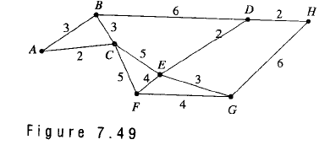
Weighted graph（加权图）
Definition:a weighted graph is a graph for which each edge is labeled with a numerical value called its weight（权值） .
Example 1
School of Computer Science, BUPT

Slide 3
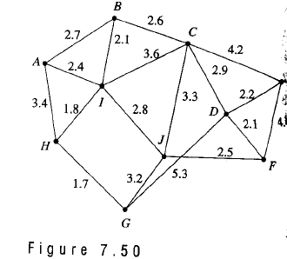
Example
School of Computer Science, BUPT

Slide 4
The weight of an edge (v_{i},v_{j}) is some times referred to as the distance between vertice v_{i} and v_{j}.
A vertex u is a nearest neighbor of vertex v if u and v are adjacent and no other vertex is joined to v by an edge of lesser weight than (u,v).
Note v may have more than one nearest neighbor.
School of Computer Science, BUPT

Slide 5
Example
School of Computer Science, BUPT

Slide 6
A vertex v is a nearest neighbor of a set of vertices V={v₁,v₂,…v_{k}} in a graph if v is adjacent to some member v_{i} of V and no other vertex adjacent to a member of V is joined by an edge of lesser weight than (v,v_{i}).
This vertex v may belong to V.
School of Computer Science, BUPT

Slide 7
Example
V={C,E,J}
D is the nearest neighbor of V.
School of Computer Science, BUPT

Slide 8
Minimum spanning tree （最小生成树）
Definition: a minimum spanning tree in a connected weighted graph is a spanning tree that has the smallest possible sum of weights of its edges.
Definition: an undirected spanning tree of a weighted graphs, for which the total weight of the edges in the tree is as small as possible. Such a spanning tree is called a minimum spanning tree.
School of Computer Science, BUPT

Slide 9
Prim’s Algorithm
Procedure Prim (G: weighted connected undirected graph with n vertices )
T:=a minimum-weight edge
For i:=1 to n-2
begin
  e:=an edge of minimum weight incident to a vertex in T and not forming a simple circuit in T if added to T
  T:= T with e added
End{ T is a minimum spanning tree of G }
School of Computer Science, BUPT

Slide 10
Theorem 1
Prim’s algorithm produces a minimal spanning tree for the relation.
Proof
    Let G have n vertex. Let T be the spanning tree for G produced by Prim’s algorithm.
    Suppose that the edges of T are t₁, t₂,…, t_{n-1} in the order of they were selected.
    we define T_{i} (i=1 to n-1) to be the tree with t₁, t₂,…, t_{i} and T₀={}Then T₀ ⊆ T₁ ⊆ … ⊆ T_{n-1}=T.
    We now proved that each T_{i} is contained in a minimal spanning tree for G by mathematical induction.
School of Computer Science, BUPT

Slide 11
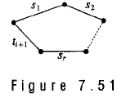
    Basis step: Clearly P(0):T₀={} is contained in every minimal spanning tree for G
    Induction Step:
      suppose P(k):T_{k} is contained in a minimal spanning tree T’ for G.
      By definition {t₁, t₂,…,t_{k}}⊆T’. If t_{k+1}also belongs to T’,then T_{k+1} ⊆ T’ and we have P(k+1) is true.
      If t_{k+1}does not belongs to T’,then T’∪{t_{k+1} }must contain a cycle.
      This cycle would be for some edges s₁, s₂,…,s_{k} in T’
      The edges of this cycle cannot all be fromT_{k} or T_{k+1} would contain this cycle.
School of Computer Science, BUPT

Slide 12
      Let s_{l} be the edge with smallest index l that is not in T_{k}. Then s_{l} has one vertex in the tree T_{k} and one not in T_{k}. So when t_{k+1} was chosen by Prim’s algorithm, s_{l} was also available.thus the weight of s_{l} is at least as large as that of t_{k+1}.
      The spanning tree (T’-{s_{l}}) ∪{t_{k+1} }contains T_{k+1}. The weight of this tree is less than or equal to the weight of T’,so it is a minimal tree for G.
      P(k+1) is true. So T_{n-1}=T is contained in a minimal spanning tree and must in fact be that minimal spanning tree.
      Q.E.D
School of Computer Science, BUPT

Slide 13
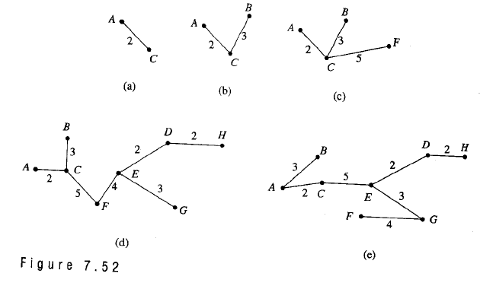
Example
School of Computer Science, BUPT

Slide 14
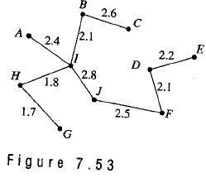
Example
School of Computer Science, BUPT

Slide 15
Kruskal’s algorithm
Let R be a symmetric,connected relation with n vertices and let S={e₁, e₂,…, e_{k}} be the set of weighted edges of R.
  Step 1 Choose an edge e₁ in S of least weight. Let E={e₁} Replace S with S-{e₁}.
  Step 2 Choose an edge e_{i} in S of least weight that will not make a cycle with members of E. Replace E with E∪{e_{i} }and S with S-{e_{i} }.
  Step 3 Repeat step 2 until |E|=n-1.
  End of algorithm
School of Computer Science, BUPT

Slide 16
Kruskal’s Algorithm
Procedure Kruskal (G: weighted connected graph with n vertices)
T:=empty graph
for i:=1 to n-1
begin
  e:=any edge in G with smallest weight that does not form a simple circuit when added to T
  T:= T with e added
end {T is a minimal spanning tree of G}
School of Computer Science, BUPT

Slide 17
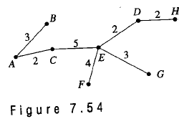
Example
School of Computer Science, BUPT

Slide 18
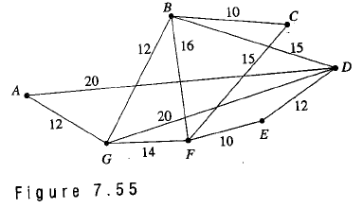
Example
Use Kruskal’s algorithm to find a minimal spanning tree for the relation given by the graph
School of Computer Science, BUPT

Slide 19
homework
§11.5
  4, 8, 10
School of Computer Science, BUPT

